Slide 1


Golden 1000 Days
Preliminary Data Collection App

Slide 2
Preliminary Data Collection App
How will it work?
HF Login
Add new To Be Mother Personal Details
Edit/Enter her data(Phase Specific Survey Data)
Store offline in app
Sync with internet when internet is available

Slide 3
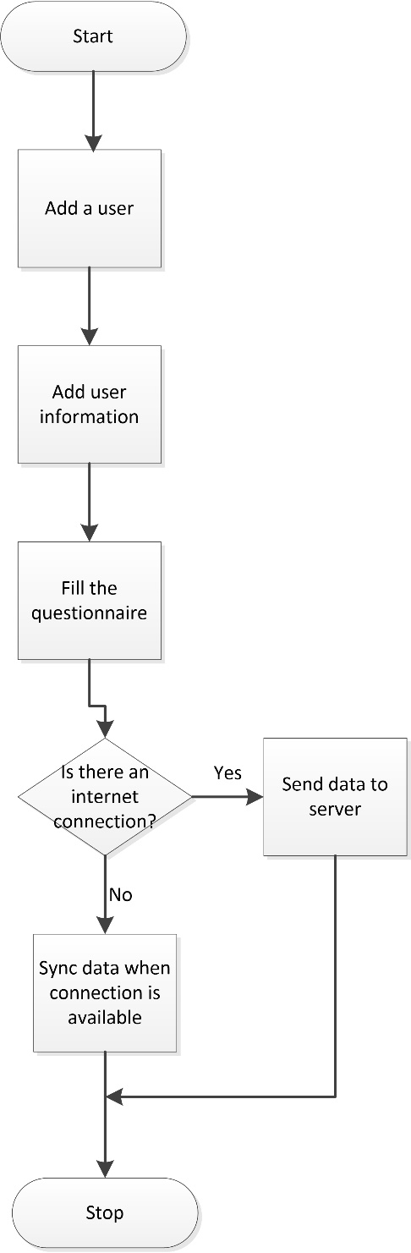

Slide 4
Database Structure
Components
HF User Table
Pregnant women information Table
Pregnancy period (Phase I) Table
10-15 months (Phase II) Table
15-21 months (Phase III) Table
22-33 months (Phase IV) Table

Slide 5
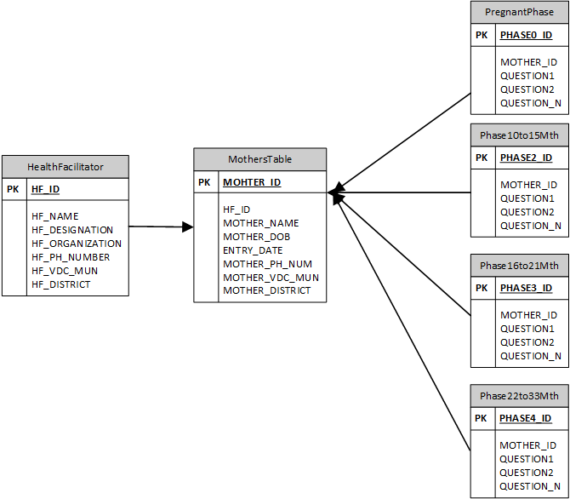

Slide 6
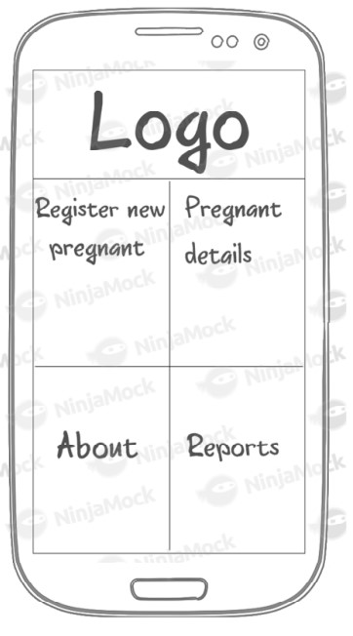
App Mock Up
Login by HF
Register New
Pregnant Details
Phase I
Phase II
Phase III
Phase IV
About (Golden 1000 days and reporting app)
Reports

Slide 7
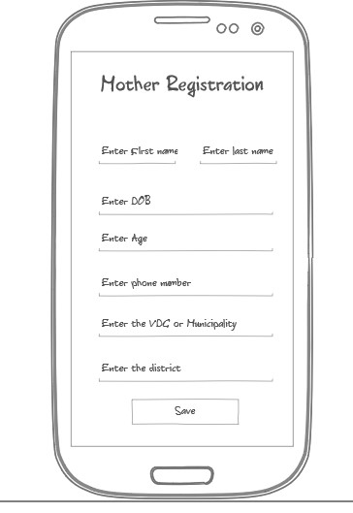
App Mock Up
Pregnant Registration Page
New Pregnant/To be Mother Details entry

Slide 8
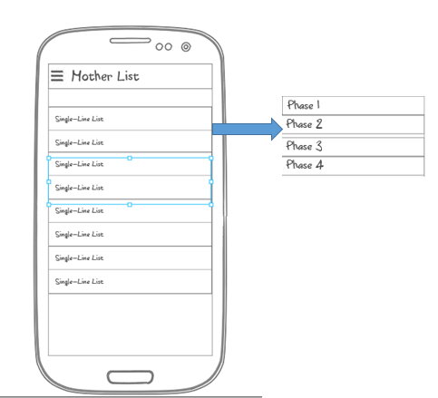
App Mock Up
Pregnant Women/Mother List
List of Pregnant women/Mothers
Form for respective Phases
(Phase I)
(Phase II)
(Phase III)
(Phase IV)

Slide 9
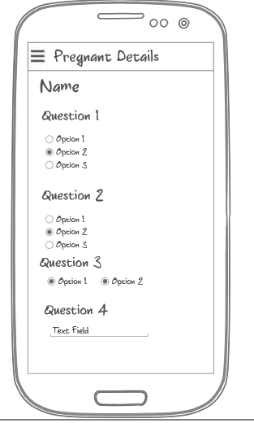
App Mock Up
Pregnant Woman Phase info
List of Questions for various phases
Questions for respective Phases
Question 1
Question 2
Question 3
……
Question N

Slide 10
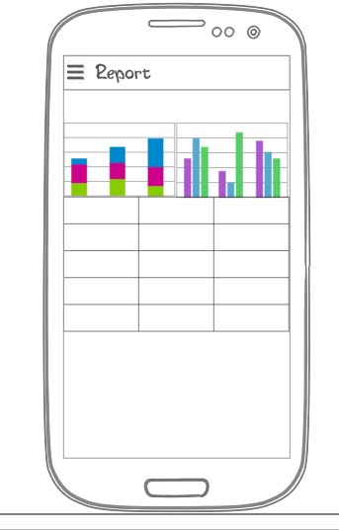
App Mock Up
Reports
Percentage wise
(Specific format required)

Slide 11
Estimated Timeline
Estimated Development time:
Data structure design: 1 week
Login Module: 1 week
Questionnaire set up: 2 weeks
Offline sync feature: 1 week
Photo upload feature: 1 week
Testing and debugging: 1 week
Total Duration: 7-8 weeks (Estimated)

